Slide 1
Class Scheduler

Slide 2
Motivation
Meeting degree requirements efficiently
Discovering courses that align with interests and career goals
Managing prerequisites
Make informed decisions on classes based on historical data

Slide 3
Our Objectives
Simplify course selection process
Provide personalized course recommendations based on student interests and career goals
Discover relevant courses and pathways within their major
Track graduation process

Slide 4
User Types
Students
Advisors
Instructor
IT Staff
Notes:
Go into roles
S – book / plan classes, track grad prog
Adv – view student roster, give feedback to students
Instructors/teach – view student rosters for sections
IT staff – add/remove classes, manage requests for access

Slide 5
Features
Personalized Recommendations
Create Course Schedule
Advising Support
Search/Filter Options

Slide 6
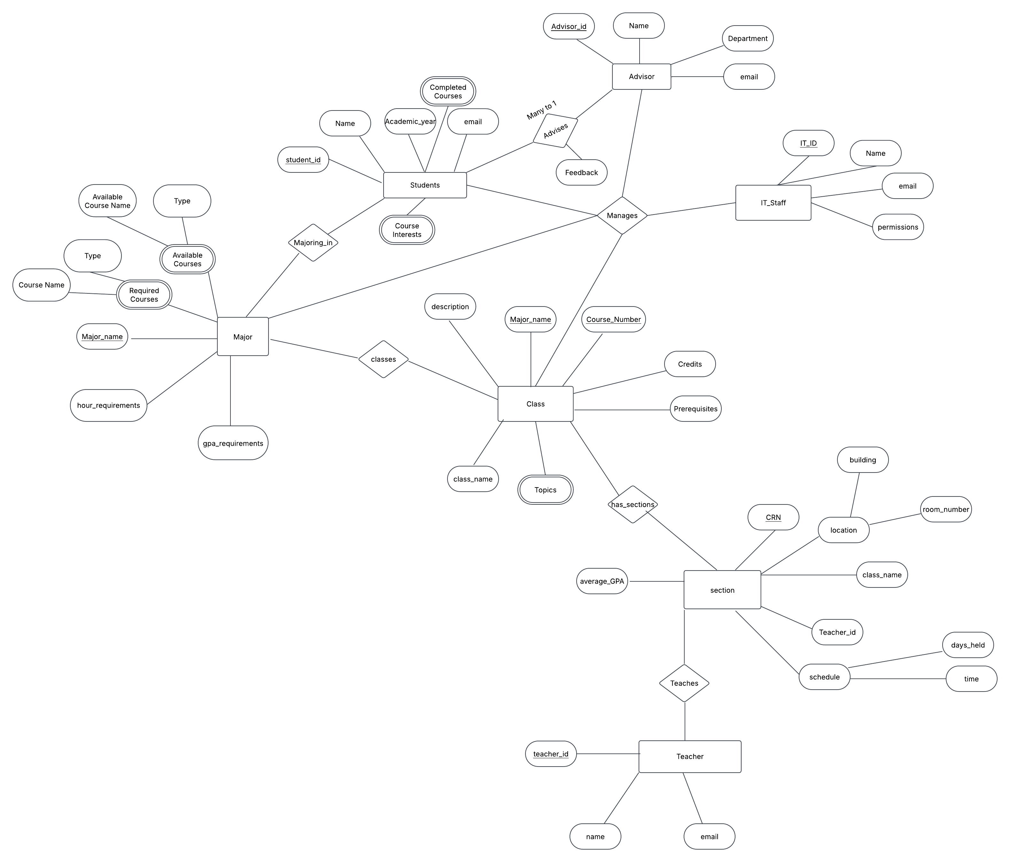
ER Diagram

Slide 9
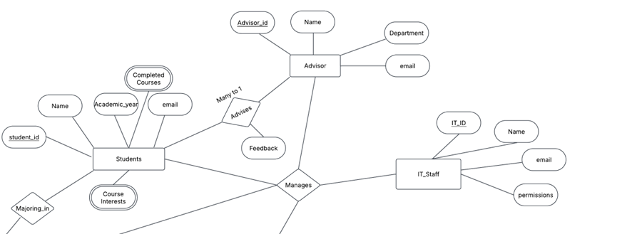

Slide 10
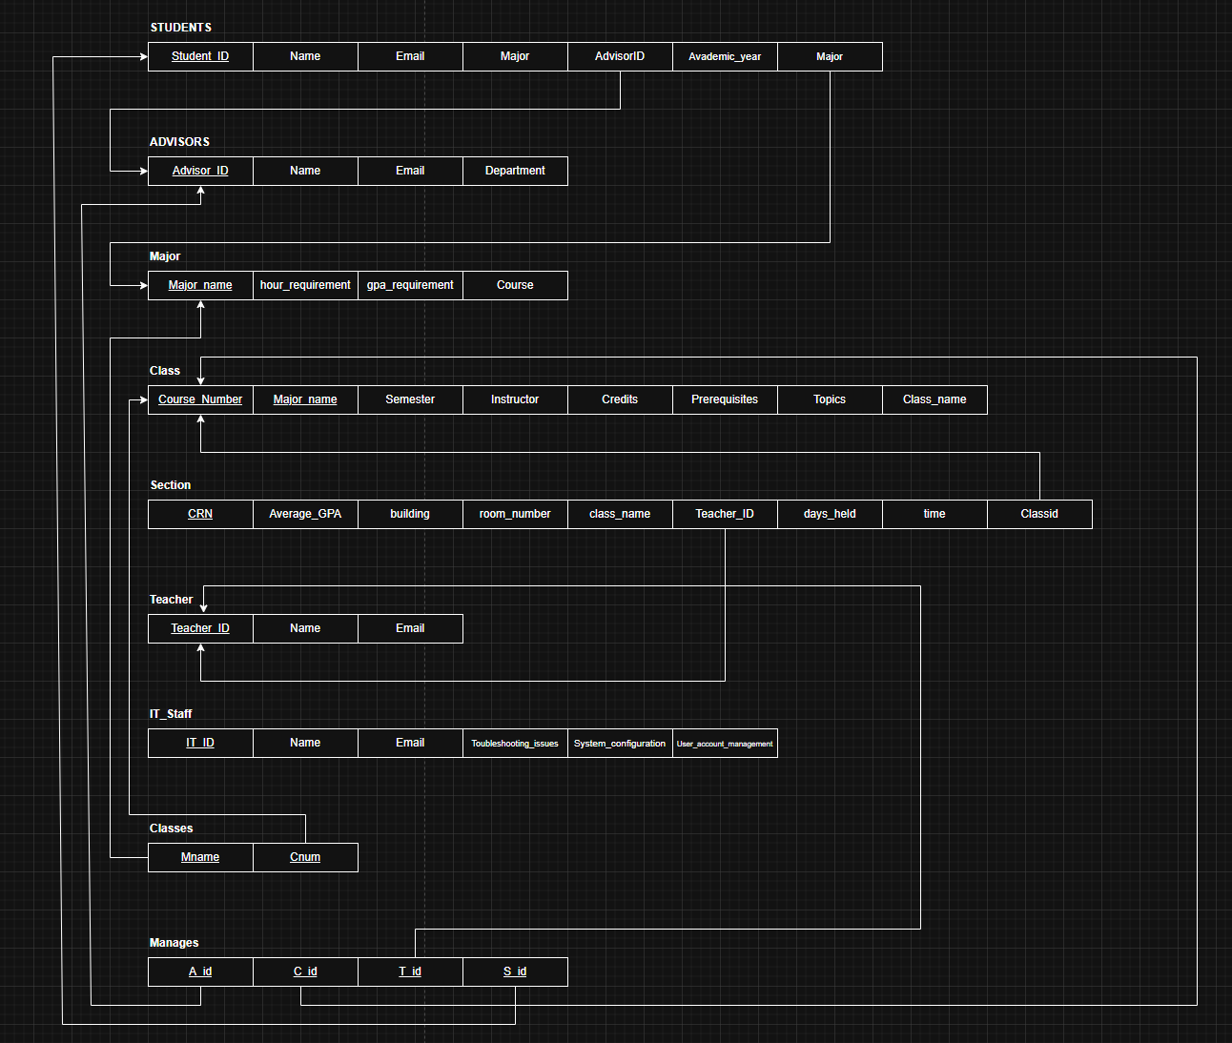
Relational Diagram

Slide 12


Slide 13
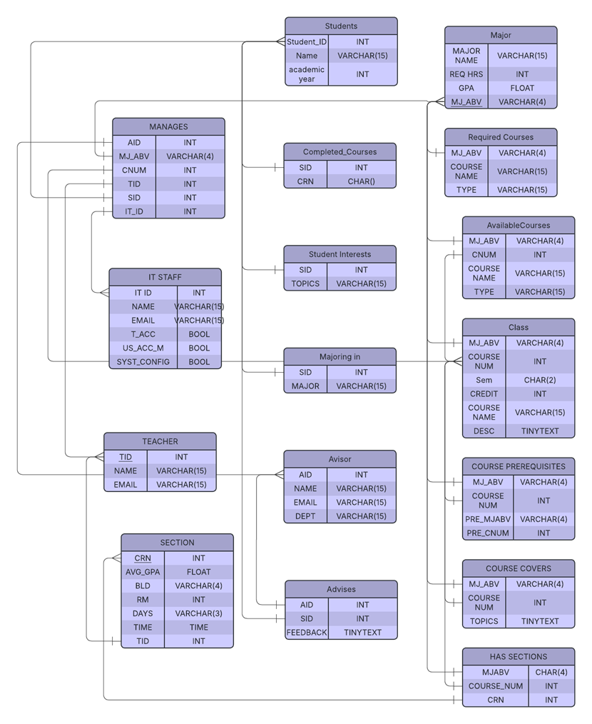
Normalized Relational Diagram

Slide 14
Tech Stack
HTML
Flask
OracleDB
Notes:
Relational model, sqlplus,
Used oracledb/ flask for backend, html for our front end library

Slide 15
Demo

